Slide 1
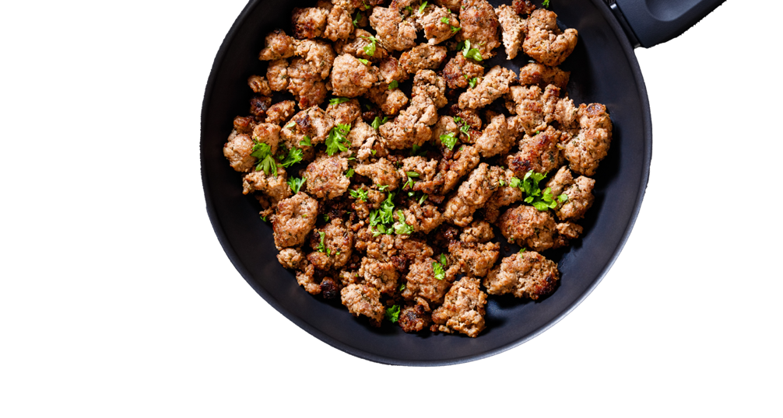

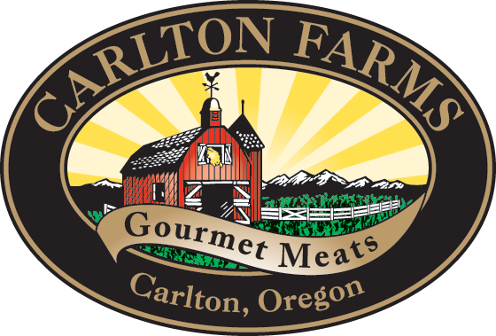
PREMIUM QUALITY
FROM THE GROUND UP
GROUND SAUSAGE ROLLS

Slide 2


HANDCRAFTING MEMORABLE EXPERIENCES
SINCE 1956.
70
YEARS OF
EXPERIENCE
Nestled in the fertile ground of Oregon’s Willamette Valley, Carlton Farms has been a trusted premium pork and specialty meats processor for nearly 70 years, committed to placing extra care into everything we do to ensure every dining occasion becomes a memorable moment. From the ethically raised animals we source to how each product is produced, packaged and delivered by the skilled hands of people we call friends, we offer premium pork products with a personal touch for those who want to guarantee that the meals they make, make memories.

Slide 3
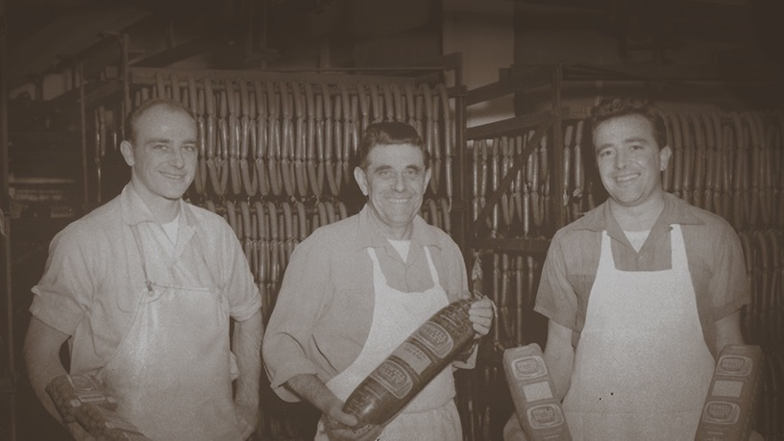
A LEGACY
BUILT ON VALUES.
Carlton Farms, originally known as “Carlton Packing Company”, was owned and operated by the Duyn family for over 60 years.
The Wilson family purchased Carlton Farms and committed to the tradition of partnering with family farmers who raise animals with care.
19
56
20
22

Slide 4
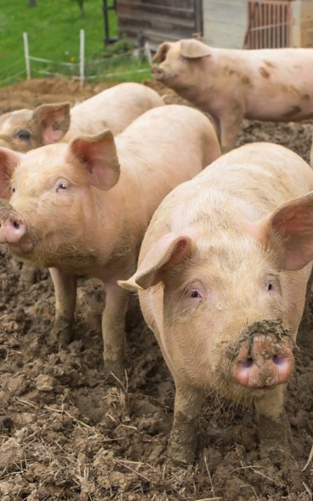
ANIMALS
RAISED
WITH CARE.
Our commitment to quality begins with the extra care that we put into animal husbandry—from the time the animal is born all the way to harvest. Our grower partners believe in time-honored methods, raising hogs humanely in environments that encourage the expression of their natural behaviors.
HEALTH
TRANSPORT
No growth accelerants.
No feed additives.
Animals are fed a 100% vegetarian diet including
Non-GMO barley and wheat.
Humane handling verified by veterinarians.
Routine stops are made in transport to ensure proper water, food and ventilation.
Travel times are scheduled to optimize animal safety.

Slide 5


A TRUE DIFFERENCE IN
HOW THE SAUSAGE GETS MADE.

Slide 6
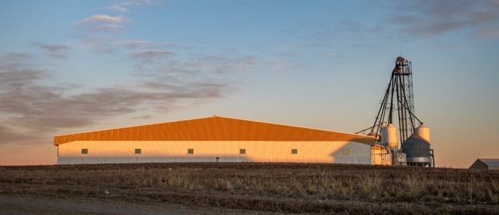
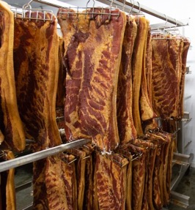
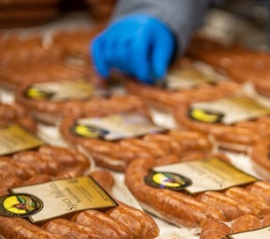
WHEN WE SAY HANDCRAFTED, WE MEAN IT LITERALLY.
All items are hand-cut by skilled fabrication technicians and hand-packaged to ensure quality and accuracy.
Products are kitchen-smoked and cured in-house with no artificial flavors or chemicals.
Every item crafted using recipes handed down through generations made with high-quality meat and simple ingredients.
Experienced and skilled team offers flexibility to meet a variety of batch sizes and specialty product requests.
Notes:
We process all of our products by hand in our Willamette Valley facility staffed with highly trained butchers from our local community who adhere to the strictest of food safety protocols—guaranteeing an elevated, memorable eating experience.

Slide 7
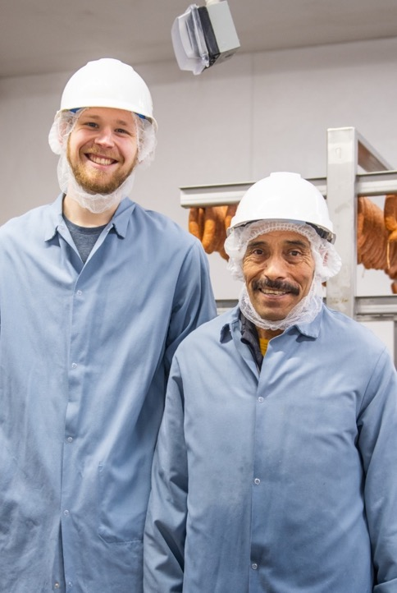
TEAM
Multi-generational family workforce
Employee retention at least 20% better than industry standard
Every employee’s child is eligible for scholarship
Enterprise class training and development opportunities ongoing
93%
OF EMPLOYEES
RANKED WORK SATISFACTION
VERY HIGH *
COMMUNITY OUTREACH & SUPPORT
OUR PEOPLE
MAKE US SPECIAL.
YCAP McMinnville – Food Bank, Housing Stabilization Energy Services
4H & FFA Yamhill County – The next generation of agriculture
Portland Fruit Tree Project – Food security, reduction of food waste
*Carlton Farms data on file.

Slide 8
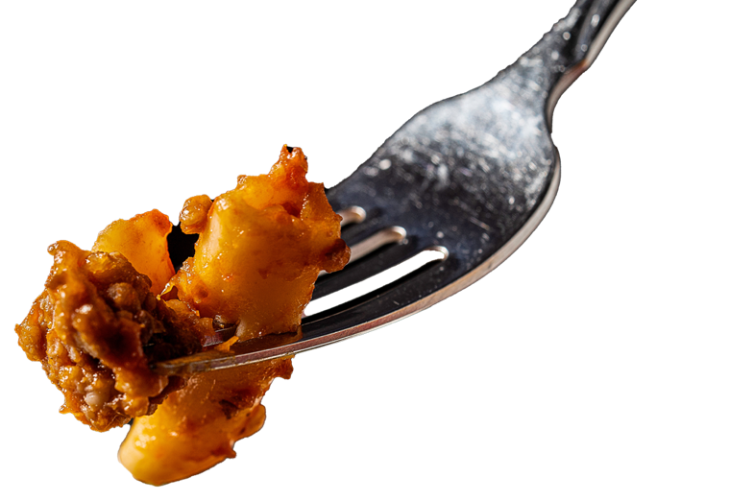
GROUND SAUSAGE
TRENDING SKYWARD.

Slide 9

CONSUMER
CONVENIENCE IS KEY.
CONSUMERS WANTS SIMPLE, EVERYDAY DINNERS.
86%
Post-COVID, consumers continue cooking at home with 86% of meals sourced from home.
Consumers want easy to portion, easy to freeze and quick to cook dinners.
OF MEALS ARE
MADE AT HOME*
*Circana, Top Trends in Fresh 2024 Webinar, May 2024.
Notes:
Convenience is key: 65% of dinners are “Simple, Everyday Dinners” or quick and easy meals; 16% are one-dish dinners. They are easy to portion (great for the record number of single-people households), easy to freeze, easy and quick to cook, and extremely versatile. Also considering price and other factors like health and sustainability.

Slide 10
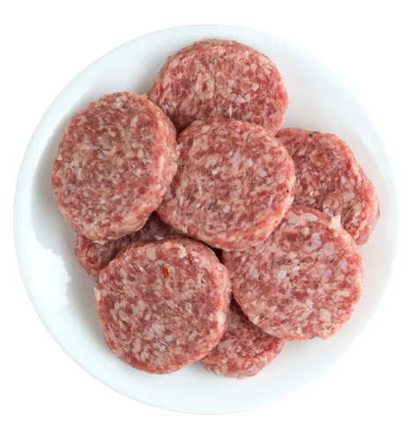
GROUND MEAT
SHOWS GROWTH.
GROUND PORK’S
MEAT MARKET
SHARE IS INCREASING.
$220M
Ground pork is gaining traction due to its lower price point, convenience, versatility and quick cook times.
Spotlight: breakfast sausage with 89% of chub/roll sausage category sales.
IN GROUND PORK SALES
*Porkbusiness.com, June 2024.
Notes:
Ground pork's meat market share is increasing, especially in breakfast sausage (89% of chub/roll sausage category sales). Ground pork sales totaled $220M. This was a 3.1% year-over-year increase in dollar sales and a 4.5% increase in pounds sold.

Slide 11
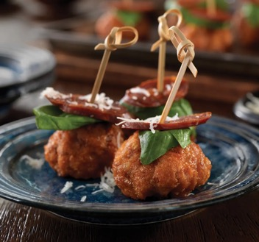
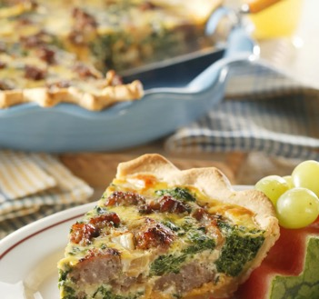
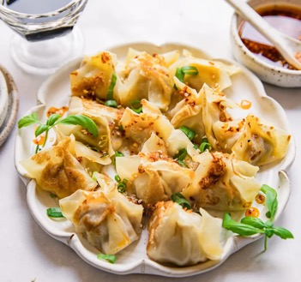
BOLD FLAVOR GOES
BEYOND BREAKFAST.
INSPIRATION FROM OUR RECIPE BOOK.
Quick and easy to cook, sausage aligns well with current consumer preferences for convenience and big flavor. But there’s more.
Courtesy of the National Pork Board, Des Moines, Iowa.

Slide 12
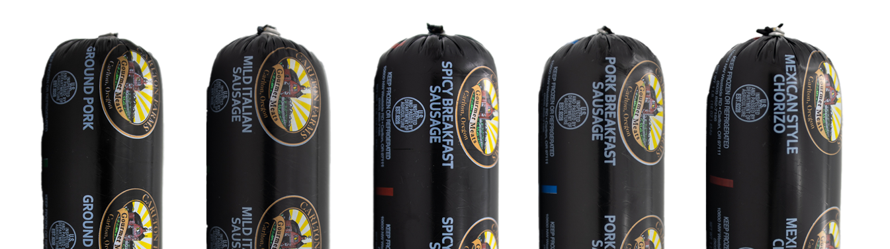
LET THE GOOD TIMES ROLL.

Slide 13
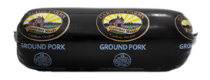
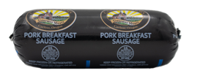
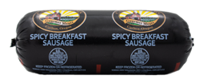
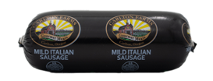
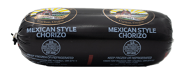
GROUND PORK
BREAKFAST
OUR LINEUP.
Carlton Farms offers a full line of premium ground pork roll varieties and flavors—perfect for any recipe or occasion.
SPICY BREAKFAST
MILD ITALIAN
MEXICAN CHORIZO

Slide 14
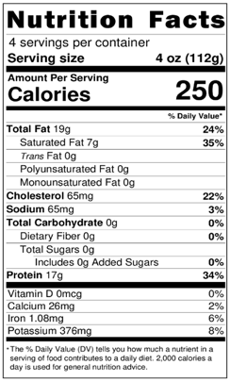
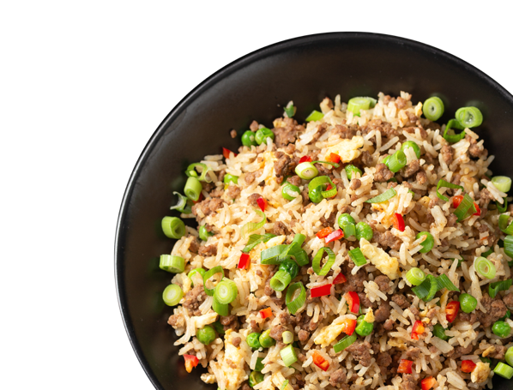
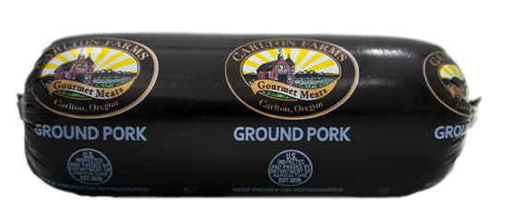
GROUND PORK
Discover the versatility and premium quality of Carlton Farms ground pork. Made from premium high-quality pork, it’s perfect for a wide range of recipes, from homemade sausages and meatballs to flavorful stir-fries and hearty pasta sauces. Easy to cook and incredibly delicious, Carlton Farms ground pork is a must-have ingredient for any meal.
INGREDIENTS: PORK

Slide 15
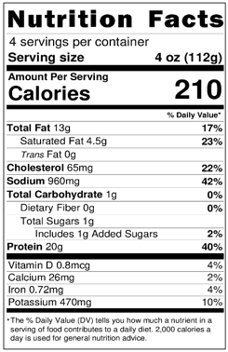

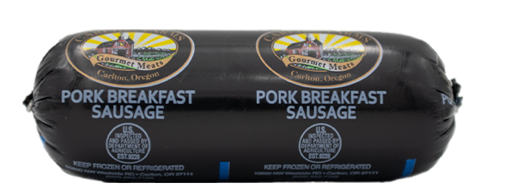
BREAKFAST
Start your mornings right with Carlton Farms pork breakfast sausage. Crafted from premium-quality pork, our breakfast sausage is seasoned to perfection with a classic blend of herbs and spices, delivering delicious savory flavor in every bite. Perfect for pairing with eggs, pancakes or biscuits.
INGREDIENTS: PORK, PORK SAUSAGE SEASONING (SALT, SUGAR, SPICES, SPICE EXTRACTIVES, MALTODEXTRIN, NOT MORE THAN 2%TETRASODIUM PYROPHOSPHATE ADDED TO PREVENTCAKING), WATER.

Slide 16
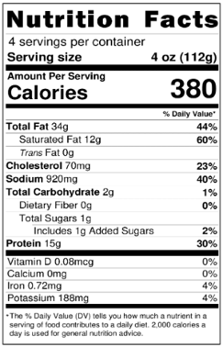
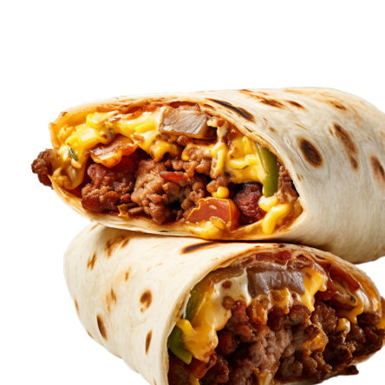
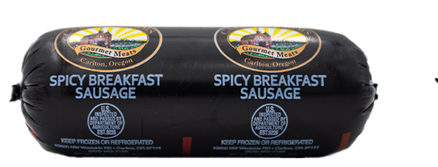
SPICY BREAKFAST
Kickstart your day with a bold and flavorful twist with Carlton Farms spicy pork breakfast sausage. Made from top-quality pork, this sausage is infused with a fiery blend of spices, delivering a delicious heat that awakens your taste buds. Perfect for adding a spicy kick to your morning meals, whether paired with eggs wrapped in a breakfast burrito or served alongside pancakes.
INGREDIENTS: PORK, PORK SAUSAGE SEASONING (SALT, SUGAR, SPICES, SPICE EXTRACTIVES, MALTODEXTRIN, NOT MORE THAN 2% TETRASODIUM PYROPHOSPHATE ADDED TO PREVENT CAKING), WATER, BROWN SUGAR, RED CHILI PEPPER FLAKES, CAYENNE PEPPER.

Slide 17
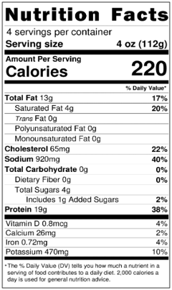
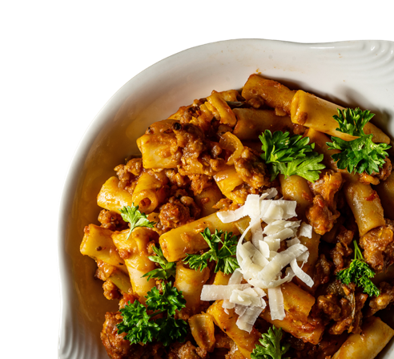
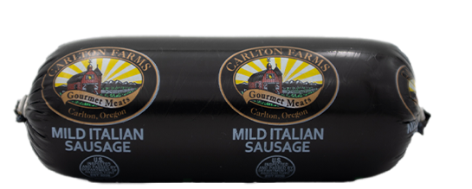
MILD ITALIAN
Indulge in the authentic taste of Italy with Carlton Farms Mild Italian pork sausage. Crafted from premium-quality pork and seasoned with a traditional blend of Italian herbs and spices, this versatile sausage is easy to cook while delivering rich and savory flavor with a mild aromatic kick.
INGREDIENTS: PORK, WATER, ITALIAN SPICE BLEND (PONDEROSA) (SALT,SPICES(INCLUDING FENNEL) PAPRIKA, YEAST EXTRACT, GARLIC POWDER, NOT MORE THAN 2% SILICON DIOXIDE ADDED TO PREVENT CAKING

Slide 18
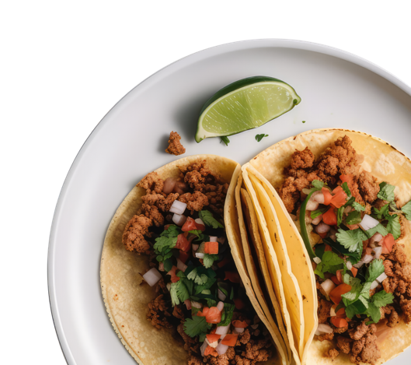
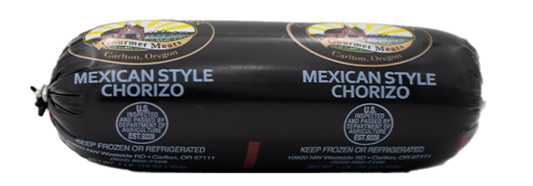
MEXICAN CHORIZO
Enjoy the taste of traditional Mexican Chorizo right at home. Made from high-quality pork , our chorizo is seasoned with an authentic blend of spices delivering a rich and bold flavor perfect for adding to your favorite recipe or standing alone on a street-style taco.
INGREDIENTS: PORK, WATER, SALT, PAPRIKA, SUGAR, VINEGAR, CHILI POWDER (CHILI POWDER,CUMIN, OREGANO, GARLIC, CORIANDER, GROUND RED PEPPER FLAKE), WHITE PEPPER, ALLSPICE, RED CHILI PEPPER FLAKES, DEHYDRATED GARLIC, CAYENNE PEPPER, OREGANO, CUMIN, CLOVES,CORIANDER, CINNAMON, NUTMEG.

Slide 19
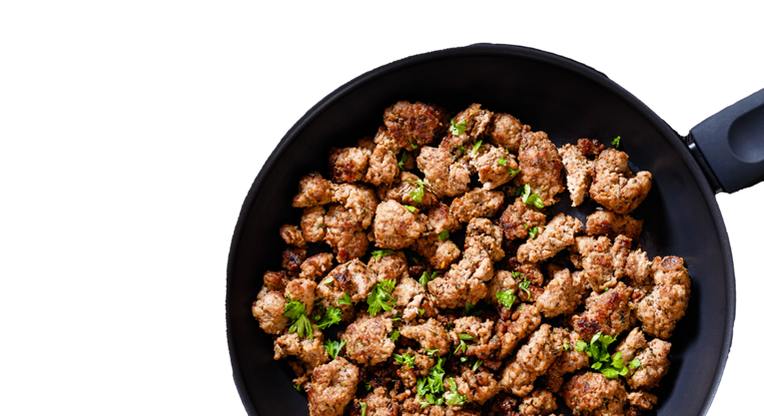
LET US START HANDCRAFTING
YOUR MEMORABLE EXPERIENCE.
For questions or to place your order today, please contact:
E: orders@carltonfarms.com
P: 503-852-7166
Carlton Farms
10600 NW West Side
Carlton, OR 97111
CARLTONFARMS.COM

